Slide 1


Understanding the Modal Shift in Response to Bike-sharing Systems in the City of Delft
－Survey data and insights
Xinwei Ma
Yufei Yuan
Niels van Oort
Serge Hoogendoorn

Slide 2
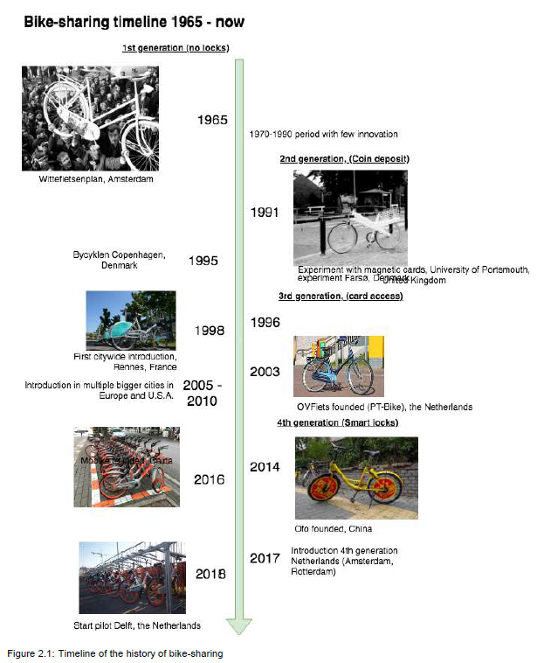
Background
Timeline of the history of bike-sharing
( Svan Boor, 2019)

Slide 3
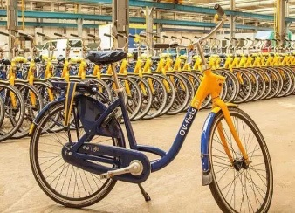
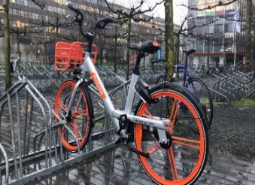
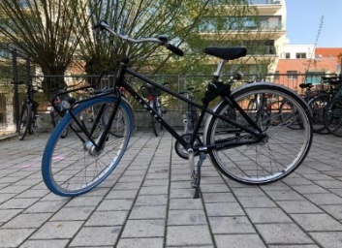
Background
01
Bike-sharing Systems in Delft, Netherlands
Bike-sharing Type | OV-fiets | Mobike | Swapfiets
Image illustration
Year Launched | 2003 | 2017 | 2014
Feature of systems | Docked bike-sharing system | Dockless bike-sharing system | Bicycle-lease system on a subscription basis
Way to use | 1.Subscription online or on a NS App 2. Using the Personal public transport chip card (NS card) to rent a bike. | 1.Subscription on a Mobike App 2.Using the Mobike App to open the bike. | Subscription online or on a Swapfiets App and get a Swapfiets bike within 1 day at a location of your choice
User pricing | € 3.85/day | € 12/month, 49.90/year or €1.5/20min | € 15/month

Slide 4
Methodology – modal shift dynamics
Who
Non-bike-sharing users? Bike-sharing users?
Why
Reasons? Barriers & Motivations
What
Modal shift caused by bike-sharing systems?
How
Relationship between Modal shift and factors (personal attributes, trip characteristics, motivations,…)

Slide 5
Part 1.
Data

Slide 6
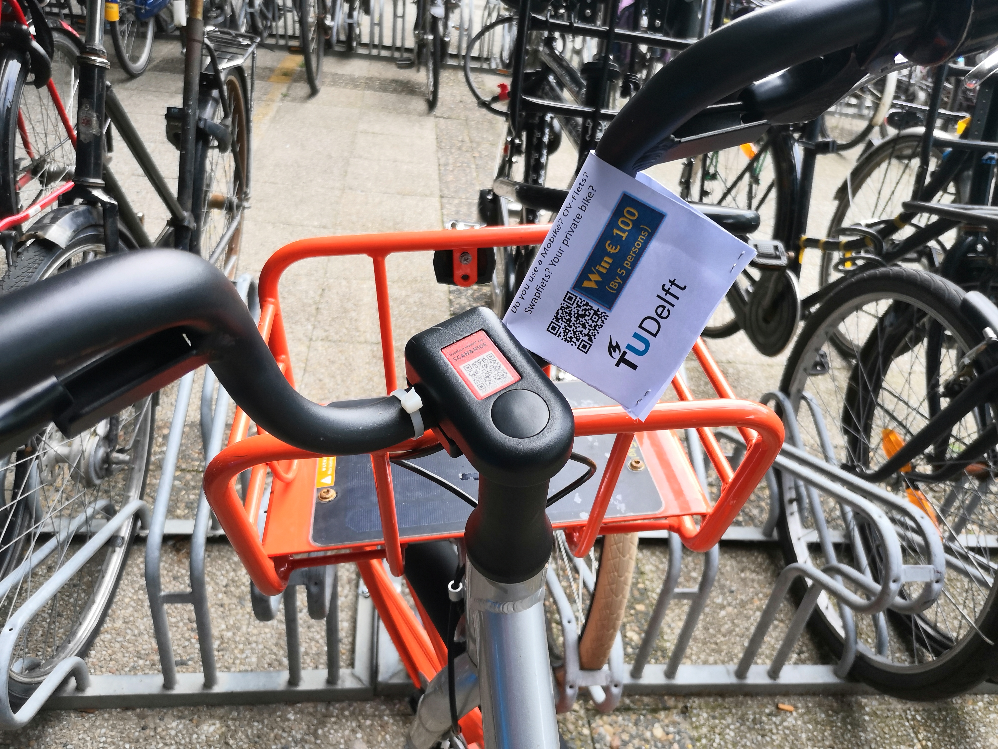
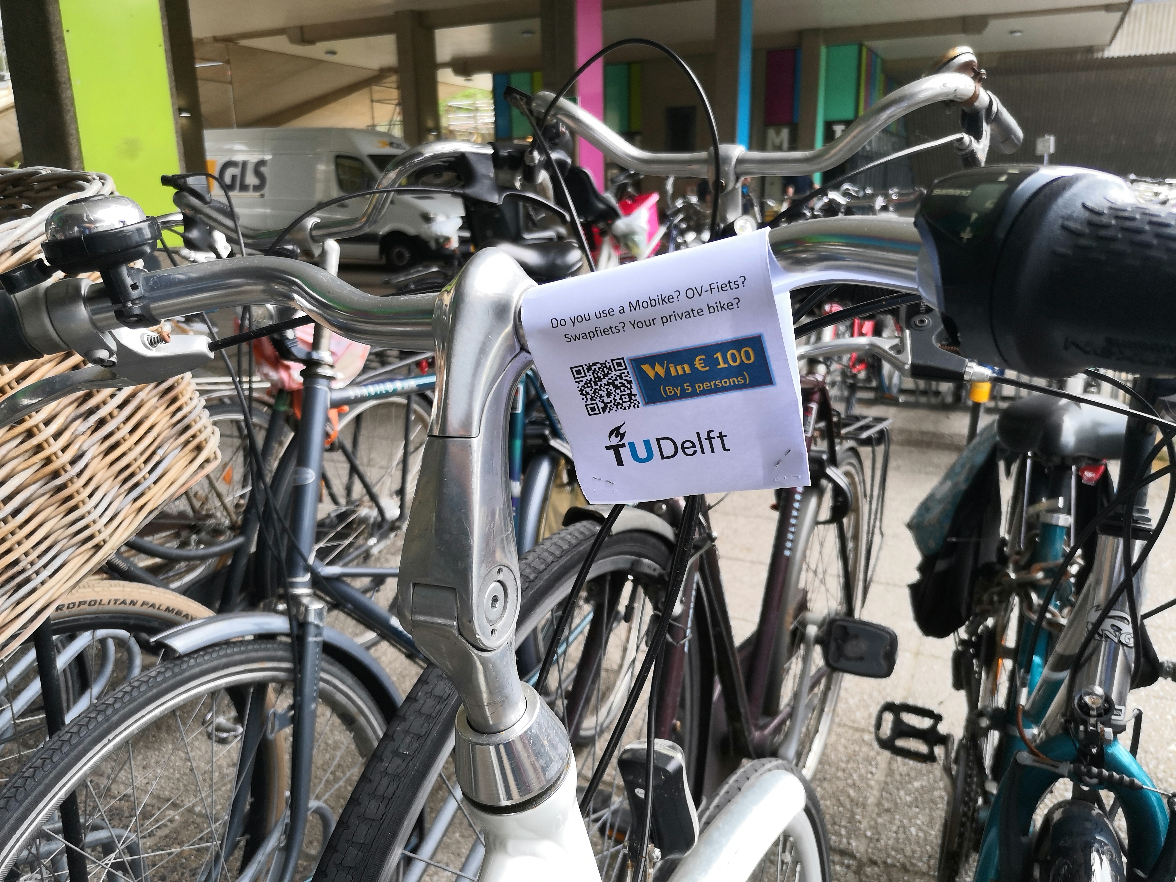
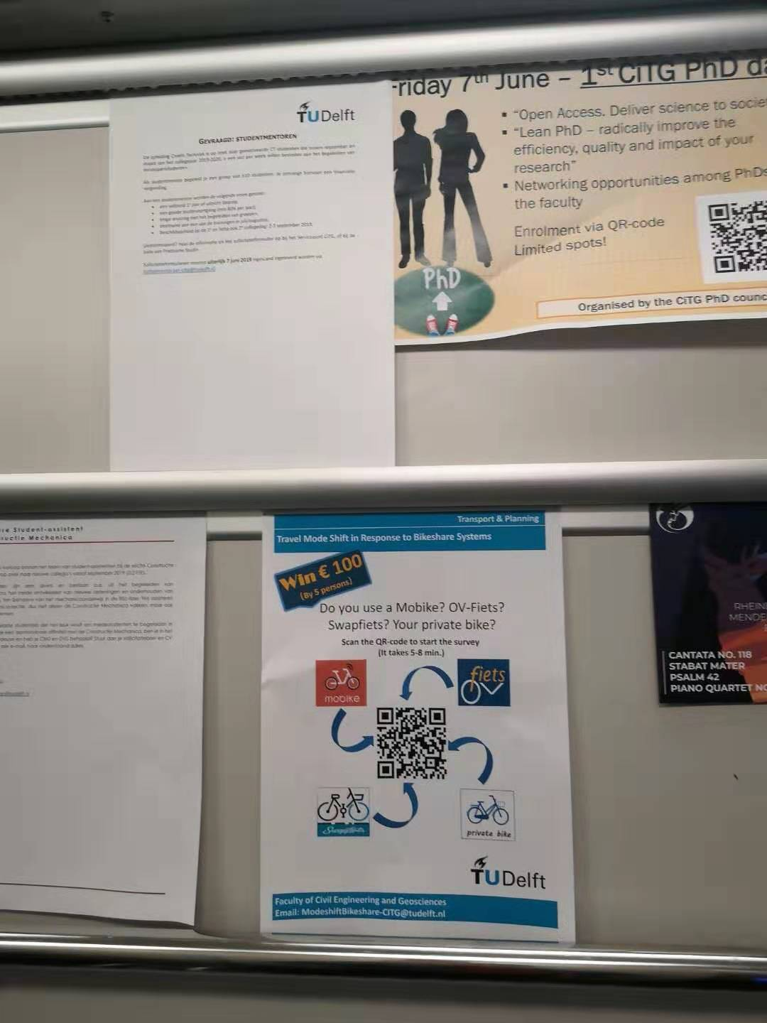
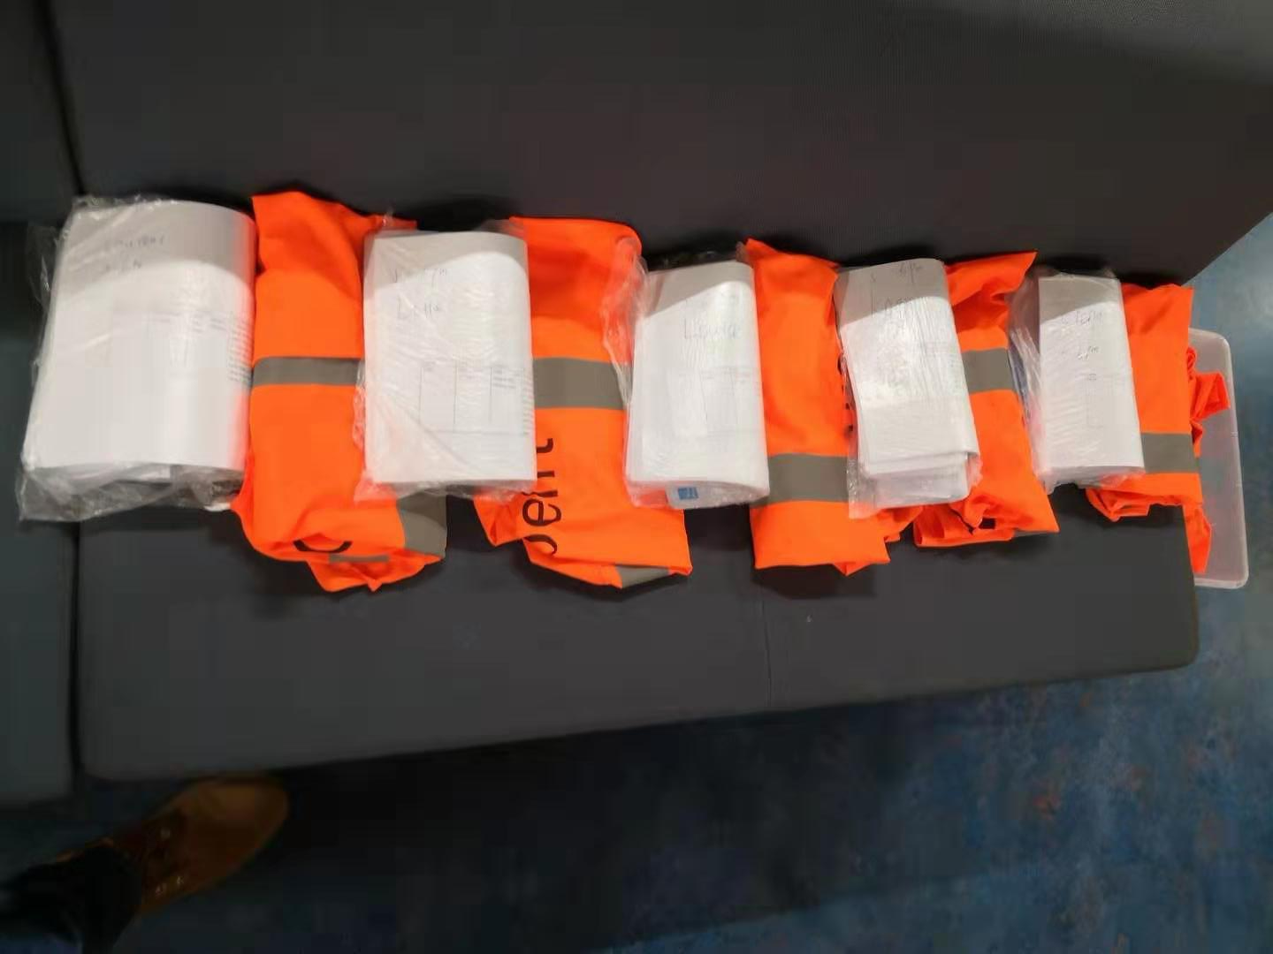
Survey design and collection
Non-bike-sharing users
Bike-sharing users
Personal characteristics
Barriers
Personal characteristics
Modal shift patterns
Motivations
Time: June and July
Student assistant: Twenty interviewers
Total respondents: 565

Slide 7
Sample composition
Nation

Slide 8
Sample composition
Gender

Slide 9
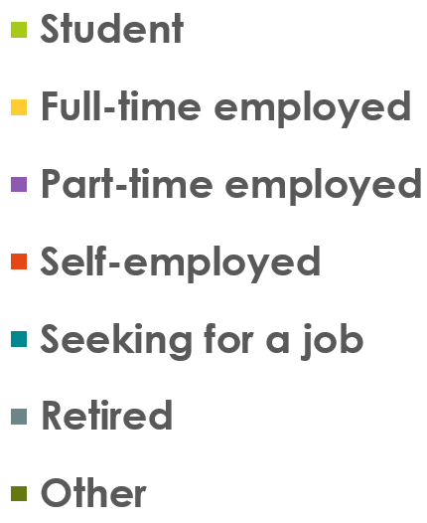
Sample composition
Employment status
Non-bike-sharing users
Mobike users
OV-fiets users
Swapfiets users

Slide 10
Part 2.
Insights

Slide 11
Findings: barriers of non-bike-sharing
Non-bike-sharing users (Barriers)
HP. | Having private bicycle
FE. | Fee charge
PB. | Poor bicycle quality

Slide 12
Findings: motivations of bike-sharing
DS. | no fixed pick-up and drop-off locations
CO. | Convenience of the app, payment method
LE. | Less effort than walking
Mobike users
ST. | Saving time
LE. | Less effort than walking
GQ. | Good quality of bikes
OV-fiets users
LW. | Less worried about bicycle being stolen/damaged
GQ. | Good quality of bikes
LE. | Less effort than walking
Swapfiets users

Slide 13
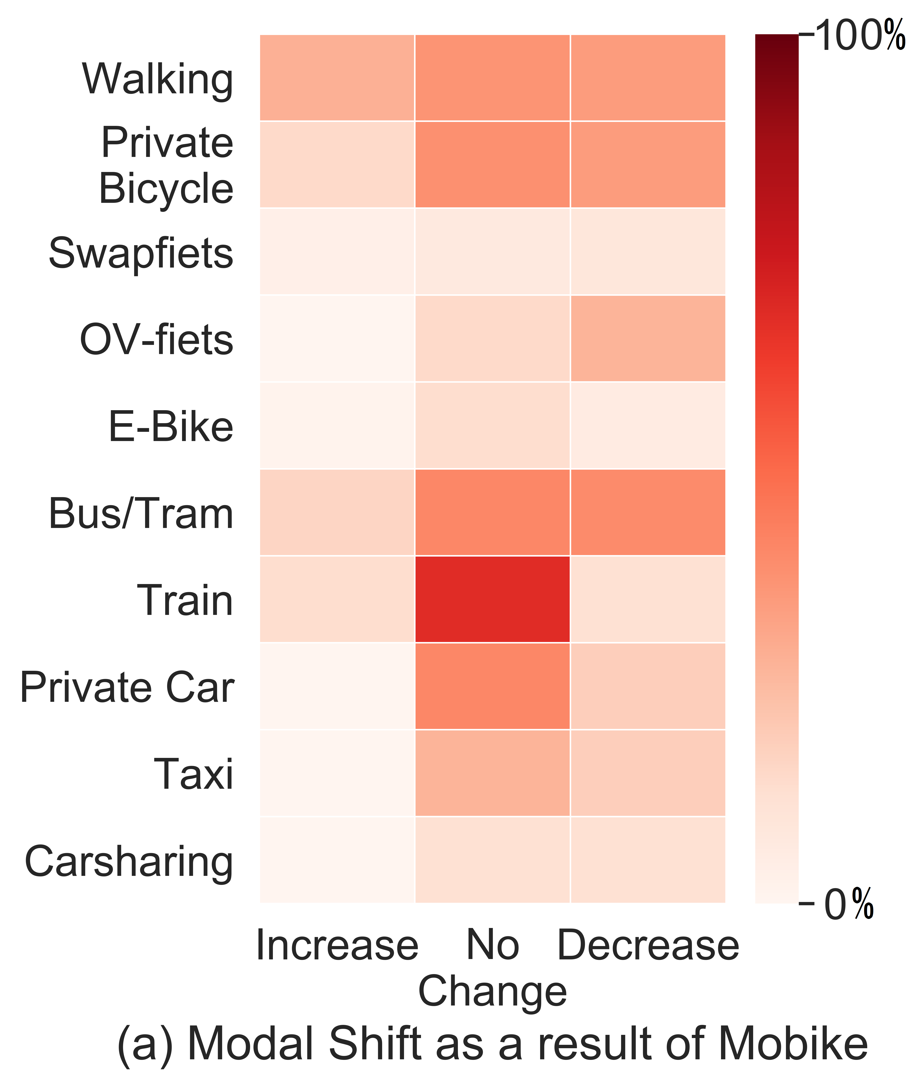
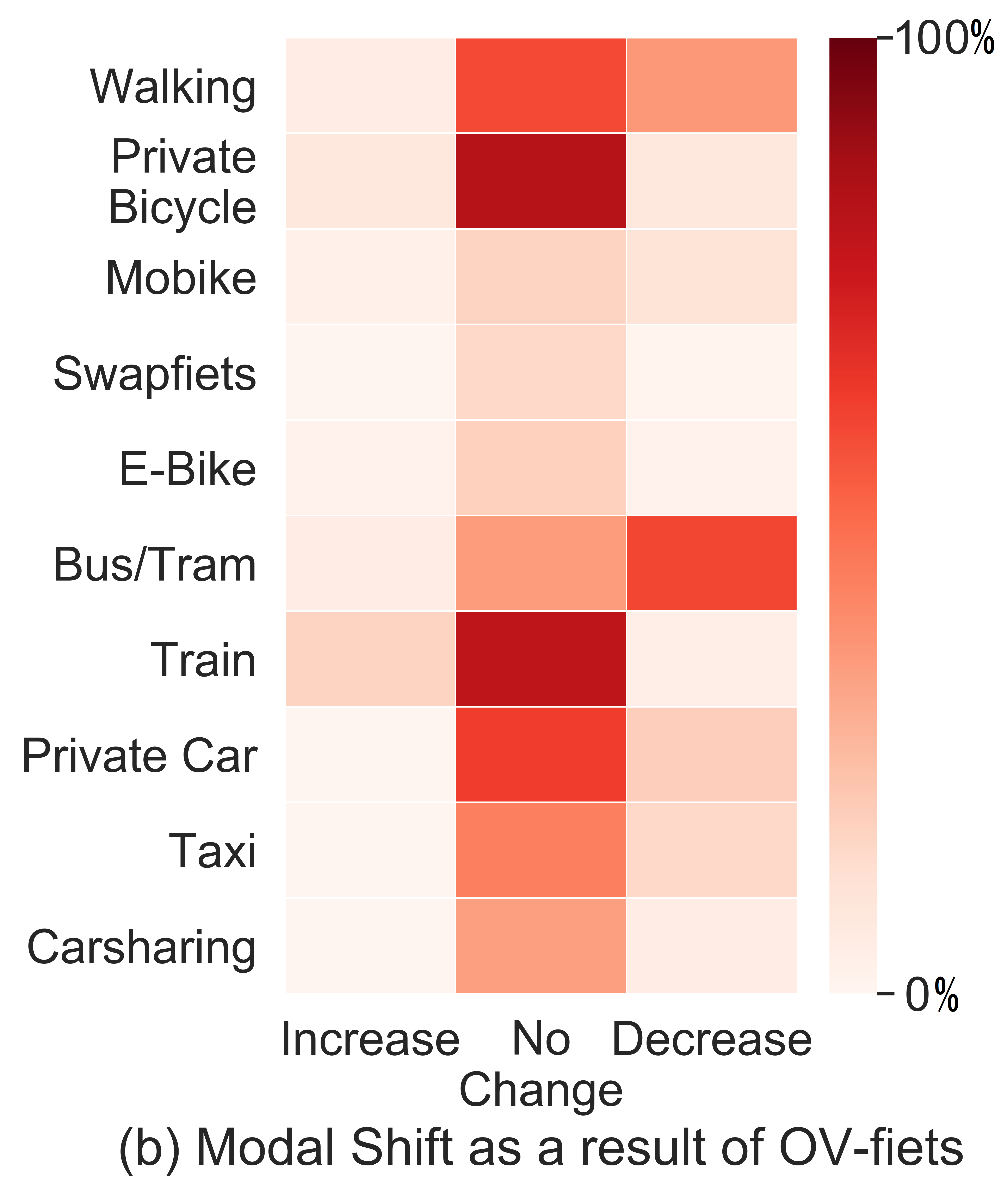
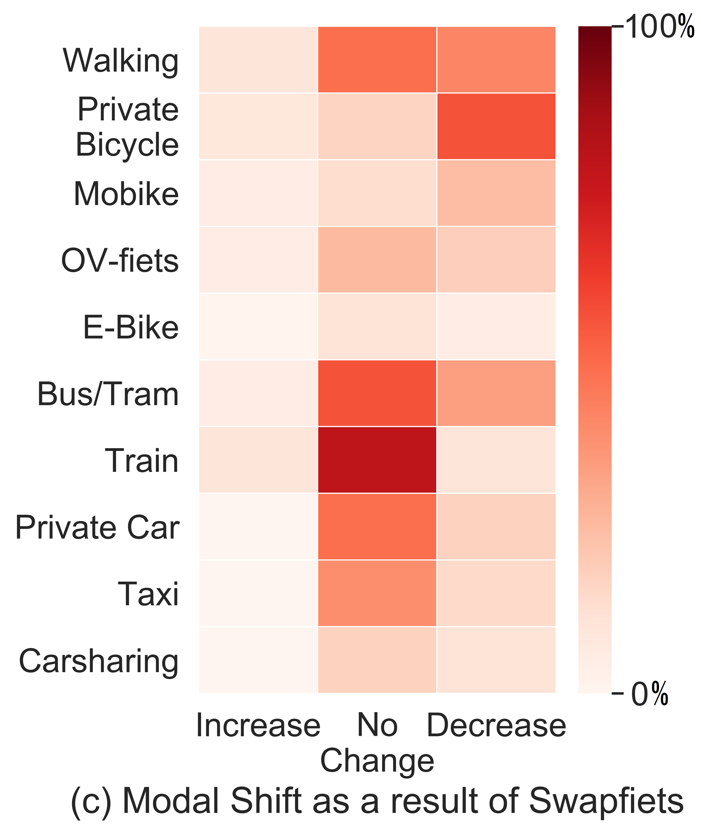
Findings: modal shift

Slide 14
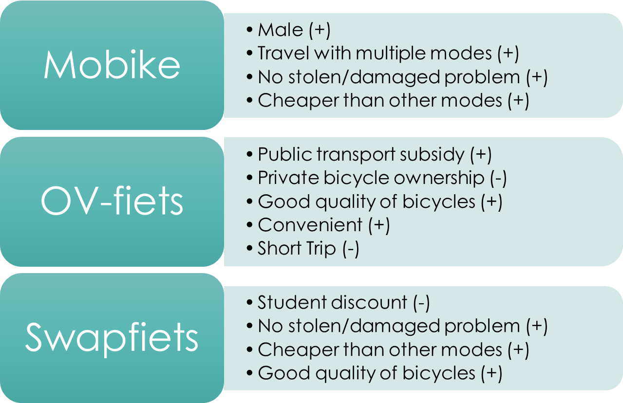
Findings: binary logit model results
Regarding commuting trips …

Slide 15
Wrap up
Personal characteristics vary between non-bike-sharing users and bike-sharing users.
Motivations are closely related to the characteristics of different bike-sharing systems.
Bike-sharing users reduce the use of walking, private bicycle, bus/tram and car. In contrast, the train use increased after the introduction of bike-sharing systems.
Effects of personal, commuting trip and motivation factors on modal shift vary among different bike-sharing systems.
Based on the observations, practical implications proposed

Slide 16
Thank you for your attention!
Xinwei Ma, Yufei Yuan, Niels van Oort and Serge Hoogendoorn
X.Ma-4@tudelft.nl, Y.Yuan@tudelft.nl
OR refer to: nielsvanoort.weblog.tudelft.nl/
Department of Transport & Planning
Faculty of Civil Engineering and Geosciences
Delft University of Technology

